Slide 1
Senior Exit Interview Presentation
Alfonso Mendoza

Slide 2
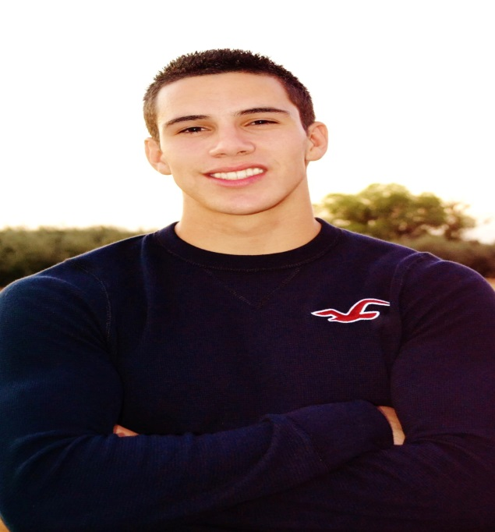
About me
Senior at LHS
17 Years old
Born and raised in Lindsay
Fitness
Guitar

Slide 3
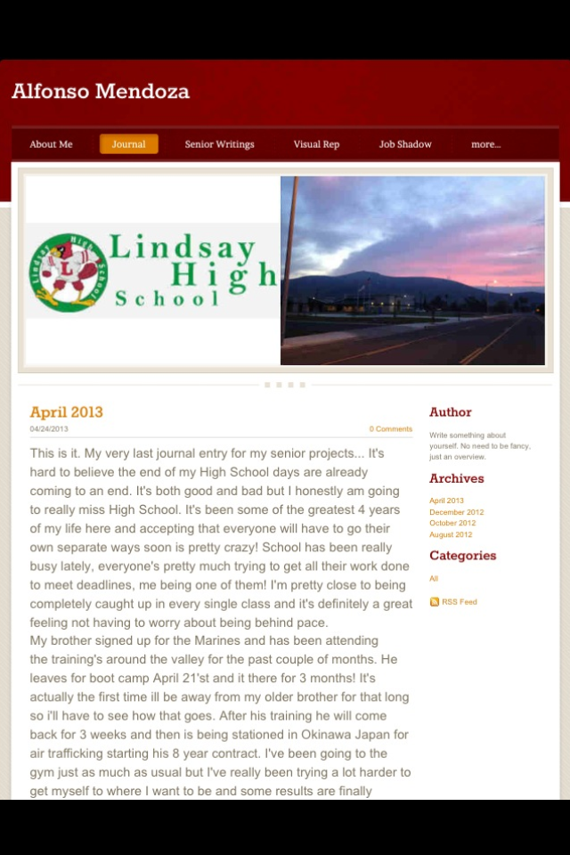
Journals
Mixed feelings for them at first.
Helpful
Keep track
Set goals

Slide 4
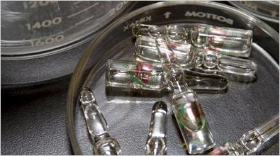
Research report
I wrote my research report on steroid abuse.
Relates to desired field of work and my own personal interests.

Slide 5
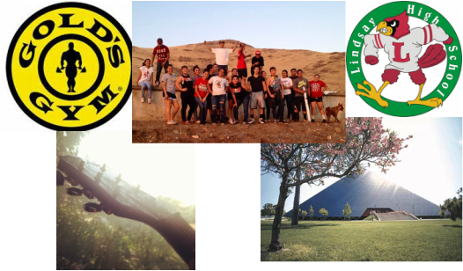
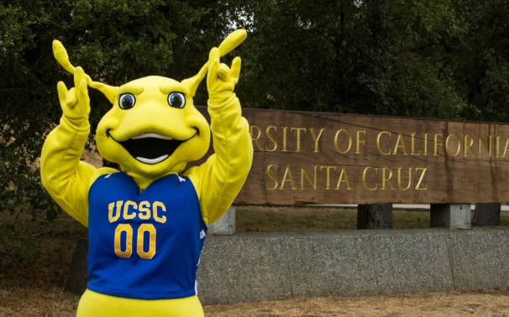
Visual Representation
Friends and family are most important.
Life after High School
College at COS
Fitness
Passion for years
Music
Guitar

Slide 6
Job Shadow
Anthony Gonzales
Personal Trainer
Physical Exercise Training
Skills required:
Good with people
Creative
Salary
Hours

Slide 7
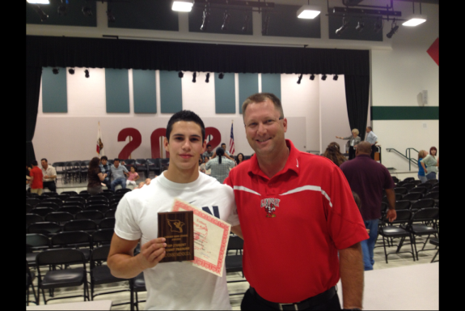
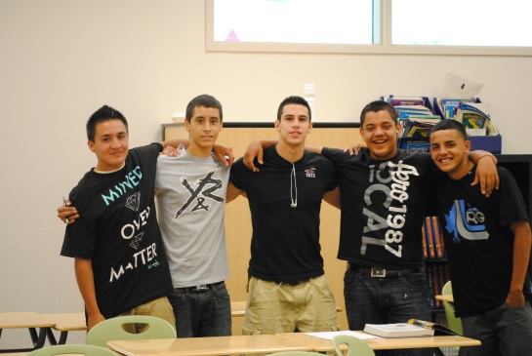
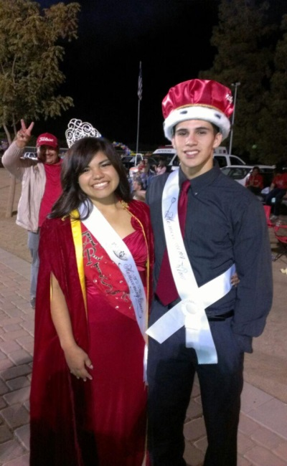
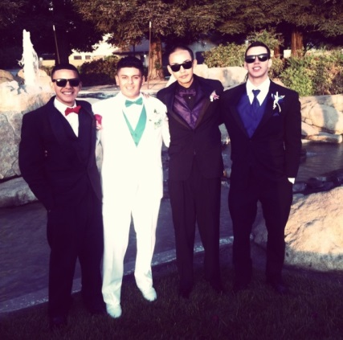
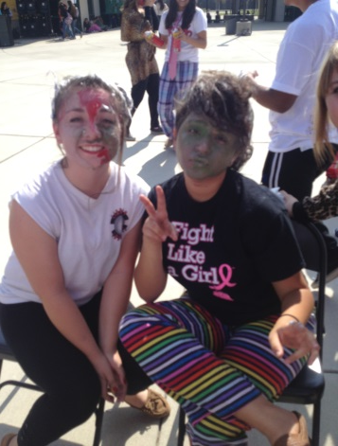
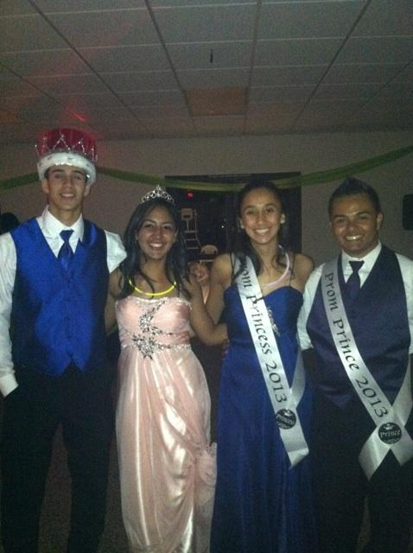
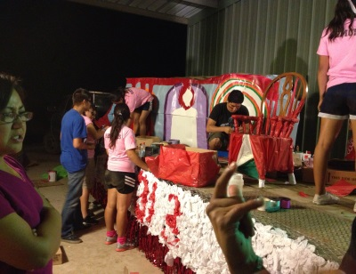
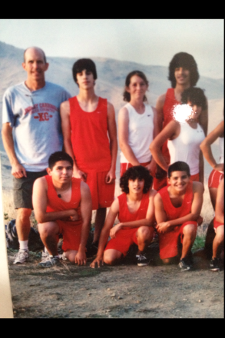
Time at LHS
Sports
Cross Country
Clubs
French Club
French Honors
Link Crew
ASB
Awards
Top Student Fitness Training

Slide 8
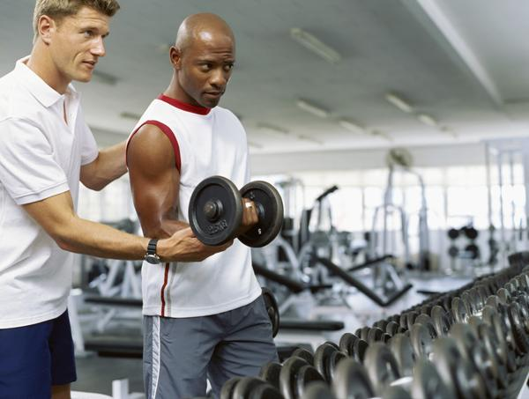
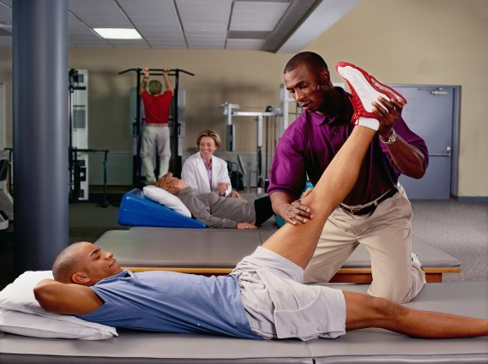
The Future
I plan on attending College of the Sequoias
Human Anatomy
Principles of Biology
Transfer to UC Santa Cruz.
Acquire BS in anything but most common are Kinesiology and exercise science.
Pursue Career in Physical Therapy
Second option, Athletic Training

Slide 9
Thank You
Any Questions?

